Slide 1



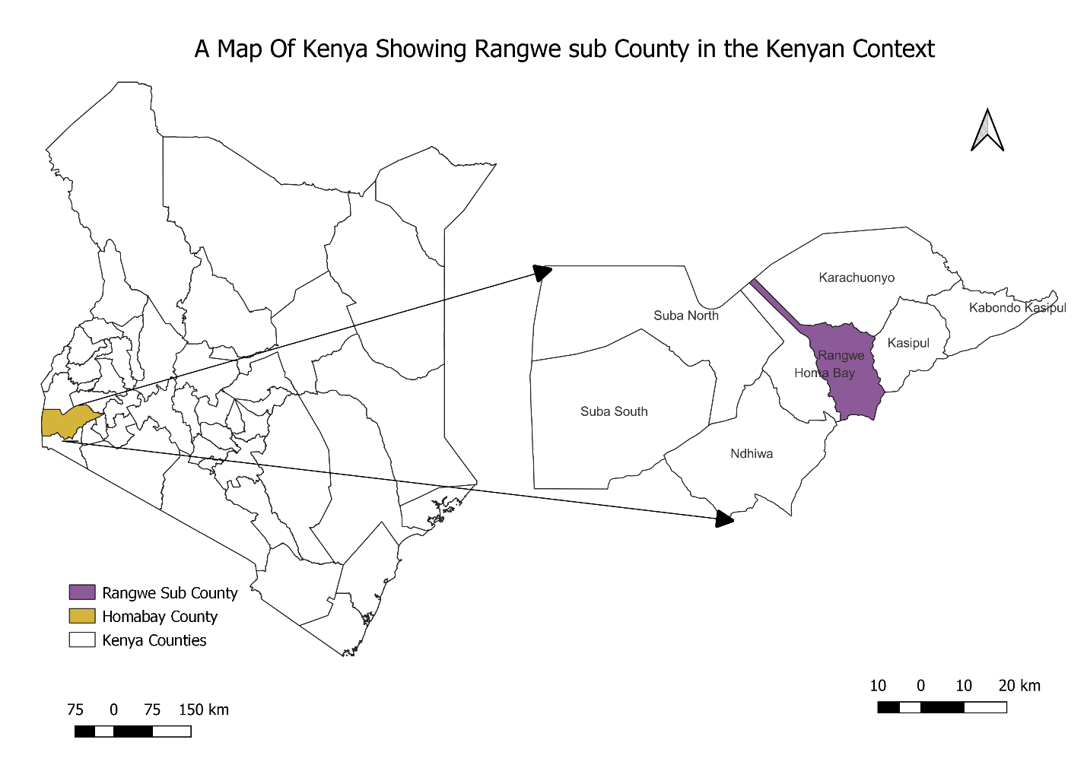
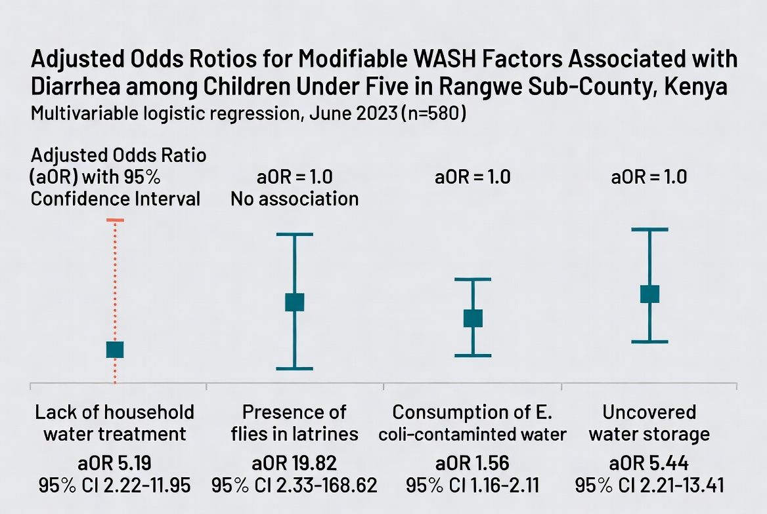


I
Prevalence and Modifiable WASH-Related Factors Associated with Diarrhea among Children Under Five in Rangwe Sub-County, Homa Bay County, Kenya
Stephen Okumu ^{1,2} , Fredrick Odhiambo^{2,3} Dr Carol Munini³
1: County Government of Homabay. 2.Kenya Field Epidemiology and Laboratory training Program 3:Kenya National Public Health Institute 4: Moi University
BACKGROUND
Diarrhea, defined as the passage of three or more loose stools within 24 hours, remains a leading cause of morbidity and mortality among children under five globally, causing an estimated 1.7 billion cases and 525,000 deaths annually. In Kenya, approximately 19,500 deaths occur each year, largely linked to inadequate water, sanitation, and hygiene (WASH). In Rangwe Sub-County, Homa Bay County, diarrhea is the fourth leading cause of morbidity and mortality.
OBJECTIVE: To determine the prevalence and modifiable WASH-related factors associated with diarrhea among children under five years in Rangwe Sub-County to inform targeted public health interventions.
METHODOLOGY: A community-based cross-sectional mixed-methods study conducted in June 2023
.
STUDY AREA: Rangwe Sub-County, Kenya
STUDY DESIGN AND SAMPLING
SAMPLING DATA COLLECTION
580 children under five years selected through multistage sampling across four wards, 11 locations, and 29 community units.
Structured caregiver questionnaires, household observational checklists assessing WASH conditions, and laboratory analysis of household drinking water for fecal contamination (E. coli).
I
DIARRHEA DEFINATION
Having three or more lose stools in 24 hours preceding the study
Figure 1 A map of Rangwe sub county in the Kenyan context
STATISTICAL ANALYSIS: Descriptive statistics for prevalence and characteristics; multivariable logistic regression to identify independent modifiable WASH-related factors associated with diarrhea.
RESULTS
Table 1 Prevalence and Associated Factors of Diarrhea among Children Under Five in Rangwe Sub-County
Characteristic / Factor | Result
Diarrhea Prevalence (2-week recall) | 22.8% (132/580)
Mean child age | 24.0 ± 13.1 months
Female children | 73.9% (n=429)
Highest prevalence by age | 33.7% (children 7–12 months)
DISCUSSION
The two-week diarrhea prevalence of 22.8% in Rangwe Sub-County remains unacceptably high. The strong associations with lack of household water treatment, poor sanitation (flies in latrines), contaminated drinking water, and unsafe water storage highlight critical gaps in household WASH practices. These modifiable risk factors present clear opportunities for targeted interventions
CONCLUSIONS
Diarrhea prevalence remains high in Rangwe Sub-County, driven by preventable WASH-related exposures. Targeted interventions like household water treatment, safe water storage, improved sanitation with vector control, and community-based hygiene behavior change should be prioritized within local public health programs to reduce disease burden
Figure 2:Adjusted odds ratios
Contact: steveokumu@gmail.com

